Slide 1


Economic Empowerment
with Blockchain
Notes:
Hi, my name is Rune Christensen, I am the CEO & Cofounder of MakerDAO & I would like to share with you how Maker creates an inclusive platform for economic empowerment. I will give you brief introduction to Maker system together with couple applications.

Slide 2
Meet Maker
An inclusive platform allowing anyone equal access to the global financial marketplace
Notes:
The next phase of the financial revolution will be unlocked when a decentralized, safe, secure stablecoin has achieved scale in the marketplace.
Maker is a decentralized autonomous organization that built the Dai Credit System.
Dai is the essential piece of the puzzle to unlock an empowered financial future.

Slide 3

Dai Stablecoin
The world’s first decentralized stablecoin
based on the Ethereum blockchain
= $1
Notes:
PAINS: 1 - Existing cryptocurrencies are too volatile to be a replacement for cash
2 - Dapps, businesses and individuals require a stable medium of exchange

Slide 4
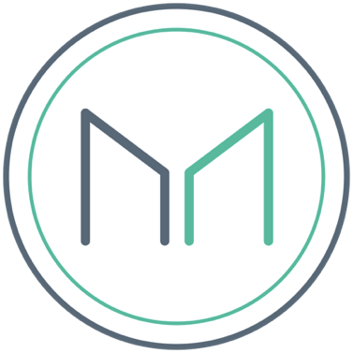
MKR Governance Token
Fuel for the credit system
A high risk, high reward volatile asset used by the decentralized regulator community
Notes:
MKR is used for voting in new collateral types and it is also used to vote on the risk parameters associated with these collateral types.
It is also a necessary ingredient to close a CDP and is thus the fuel for the Dai Credit System

Slide 5
Maker as a stable platform
International Remittances
Supply Chain Financing
Consumer Credit
Reduced Counterparty Risk
Transparent Accounting
Notes:
To summarize, here is a non-exhaustive list of some examples of the use cases for utilizing the Dai Credit System.

Slide 6
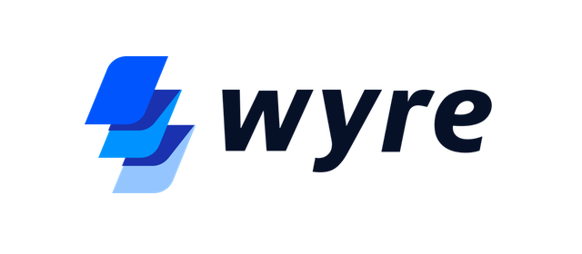
International Remittance: MakerDAO x Wyre
Easy on & off-ramp between fiat and crypto
Access to Dai Stablecoin for Businesses in 30+ Countries
Notes:
“We’re committed to developing partnerships with leaders like MakerDAO to enable the blockchain ecosystem to evolve at a faster pace. With our API developers can leverage our experience in banking and compliance with the stability of Dai stablecoin to build and engage their communities, cutting through the red tape, and leaving the off-chain complications to a regulated money services business.” — Michael Dunworth, CEO of Wyre.

Slide 7
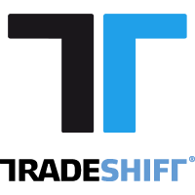
Supply Chain: MakerDAO x Tradeshift
Unlocking Liquidity across the Supply Chain
Access to capital for managing cash flow
Notes:
“Tradeshift has always been about helping businesses transform through technology, ”said Gert Sylvest, co-founder of Tradeshift and GM of Tradeshift Frontiers, the Digital innovation arm of Tradeshift “By developing a supply chain liquidity marketplace together with MakerDAO we’re helping MSME users of Tradeshift Cash leverage the power of the blockchain to solve a critical issue for them: access to capital for managing cash flow.”

Slide 8
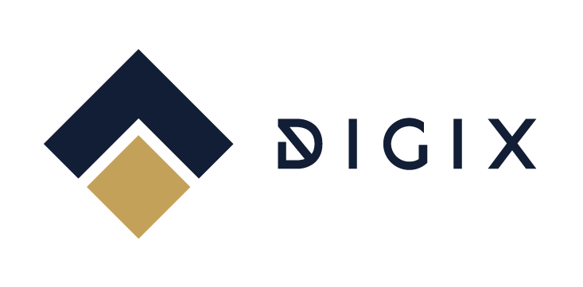
Multi Collateral: MakerDAO x Digix
DGX gold tokens as Dai collateral
Delivering resilient stablecoin to the blockchain ecosystem
Notes:
On the search for real world assets and security tokens to act as Dai Collateral (to build the ultimate - very resilient stablecoin), we have partnered with Digix to introduce MCD as gold backed stablecoin. Digix comes from one or more crypto-friendly jurisdictions, Singapore.

Slide 9
Maker elements
mkr.tools
dai.makerdao.com
Oasis.direct
oasisdex.com
Notes:
Mkr.tools - is the place to see the current overcollateralization ratio along with many other metrics related to the health of the Dai Credit System
Dai.makerdao.com is where CDPs can be created and managed
Oasis.direct is a decentralized coin swapping service where you can easily purchase small amounts of MKR or Dai using metamask or parity
Oasisdex.com a decentralized exchange where you can purchase larger amounts of Dai, MKR and a number of other tokens using metamask or parity.

Slide 10
Maker Community
Website: makerdao.com
Reddit: /r/makerdao
Chat: chat.makerdao.com
Twitter: @MakerDAO
Notes:
We have a very active community on our chat and subreddit, if any questions materialize in subsequent days - I would invite you to join the discussion there.

Slide 11
Thank you!
Notes:
Thank you everyone for your time and attention.
If you have any questions all about the Dai Credit System, there will be time for these in the Q&A section.

Slide 12
APPENDIX

Slide 13
Why Maker
Dai stablecoin - Soft pegged to USD
• Asset-backed hard currency
• Permissionless credit system
Notes:
Hard currency - because it’s backed by more locked assets than those that are in circulation
Permissionless means that anyone anywhere can use it at anytime

Slide 14
But first...
Not all stablecoins are equal
IOU
Seigniorage
Share
≠
≠
Notes:
Let’s take a quick look at the various forms of stable coin systems that are either planned or are in existence today:
Centralized:
IOU Model: (a token which is based on the principle of “when you give me fiat, then i give you a token which signifies that I owe you the redeemable value of that token”) Holders of the token need to trust a traditional, centralized organization or a legal agreement.
Decentralized & enabled by smart contracts:
Seigniorage shares model: Trust that the future value of the underlying bonds always increases, the economics incentives and structure are sound and that the smart contracts are secure.
Over-collateralized, Globally settleable Model: Trust the security of the smart contracts and the economic incentivizes and structure which ensure it’s stability.

Slide 15
Timeline
Sai (Alpha)
December 2016
Dai (Beta)
December 2017
Multi-Collateral Dai
Q4
2018

Slide 16
Use case #1
Stability
Notes:
The first way to interact with the Dai Credit System is for stability seekers looking to hedge out of more volatile assets or for a safe, secure store of value or unit of account on-chain. These users will hold and use Dai.

Slide 17


Collateralized Debt Position (CDP)
Notes:
The second and third reasons one would interact with the Dai Credit System is via what we call a Collateralized Debt Position, or CDP for short. Both of these use cases are speculative and are dependent on the creator having faith in the future value increase of the asset they are depositing into the CDP.

Slide 18
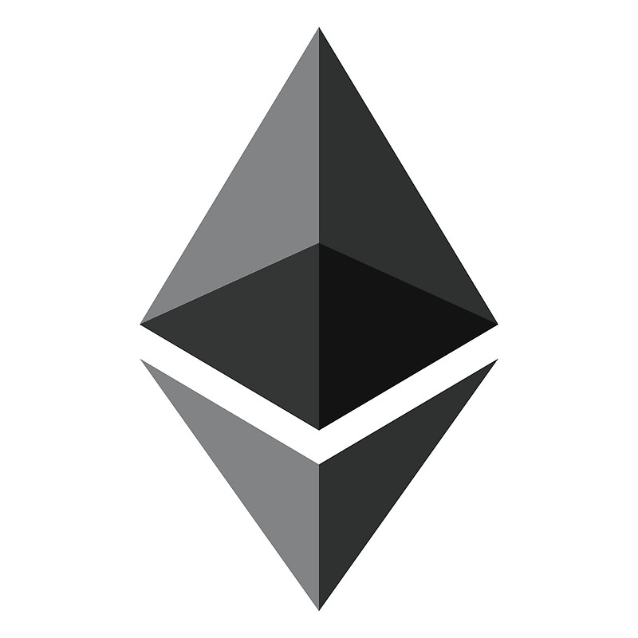


Use case #2
Accessible, asset backed loans
Notes:
So, for example if you hold ethereum or gold via DGX (or in the future virtually any asset that can be tokenized), you can deposit your token into a CDP and take out a loan against that collateral. If the price goes up, you profit from the continued holding of that asset while at the same time you were able to utilize the cash you removed from the CDP so that you could do whatever you needed to do with it. Some CDP owners have already used CDP’s to hold their ETH while paying their bills, buying a new car and even a purchasing a house using the cash drawn from a CDP.

Slide 19



Use case #3
Low counterparty risk & margin trading
Notes:
The last use case for CDP’s is low Counterparty risk margin trading. Currently if you want to increase your exposure to an asset like Ethereum it’s necessary to trust the exchange where you deposited your funds to not get hacked or run off with your funds. With CDP’s you never lose custody of your funds and can increase your exposure in excess of 3x today. It’s also important to note here that this is not free money and there is a corresponding risk of liquidation of your CDP in the case that the value of the asset you’ve deposited drops in value to where your stop or liquidation point is. If that is hit, the CDP will be liquidated automatically and a 13 percent liquidation fee will be applied to the ETH deposited into the CDP before being returned to you.

Slide 20
Properties of a durable stablecoin
Multi-collateral:
Resilience in the face of black swans.
Notes:
The current version of Dai in the wild is single collateral which means that if a black swan were to occur and the price of ETH was to drop instantaneously across all exchanges at once to 0, then Dai would fail. The multi collateral version of Dai is due to be released soon will be resilient even in the face of such an event because the collateral pool will be diversified with non-correlated assets. This means that even if one collateral type fails completely that Dai holders would still be made whole because all CDPs in which the Dai were created are all over-collateralized.

Slide 21
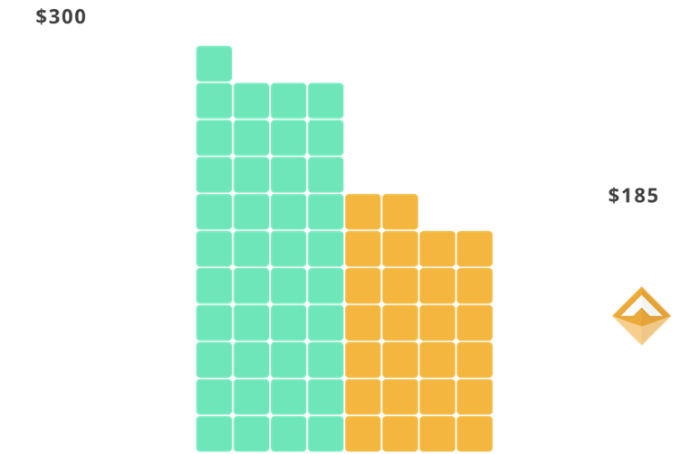
Properties of a durable stablecoin
Over collateralized:
Always a higher value of collateralized assets backing Dai than the Dai in circulation.
Notes:
Overcollateralization ensures that in event of a rapid decrease in asset price that a CDP can be liquidated with extra value to spare. This ensures that Dai holders can sleep well at night knowing that no matter what happens to the price of the asset backing their Dai that they can always receive equivalent value of the assets backing the Dai in circulation.

Slide 22
Properties of a durable stablecoin
Global settlement:
The ultimate peg enforcement mechanism. Supported by arbitrageurs banking on overcollateralization.
Notes:
The last method we use to ensure stability and security of the system is what we call global settlement.
At any point in time if the price of Dai strays too far away from the dollar... the system can be “globally settled”.
This means that the value of the assets which back each Dai can be made available to be redeemed by each Dai holder.
This THREAT ensures that a class of motivated actors called keepers can in good faith provide liquidity on either side of the peg and make a profit doing so as they know that if the price moves far enough away from the peg that the system can and will be settled.

Slide 23
Properties of a durable stablecoin
Over collateralized:
Always the equivalent of more money backing Dai than the Dai in circulation.
Multi-collateral:
Resilience in the face of black swans.
Global settlement:
The ultimate peg enforcement mechanism. Supported by arbitrageurs banking on overcollateralization.
Notes:
To summarize, these are the methods that ensure the security and stability of multi collateral Dai:
Diversifed, uncorrelated collateral pool which is thus reslient in the face of black swans
Over collateralization and the threat of global settlement at any time ensure the stability of Dai.
Arbitrageurs provide liquidity at the peg because they know that the system can be shut down at any time and have exactly $1 worth of collateral returned to them.
The old instance of Dai is then rendered invalid and the holder is prompted to migrate to the new instance by redeeming the old instance

Slide 24
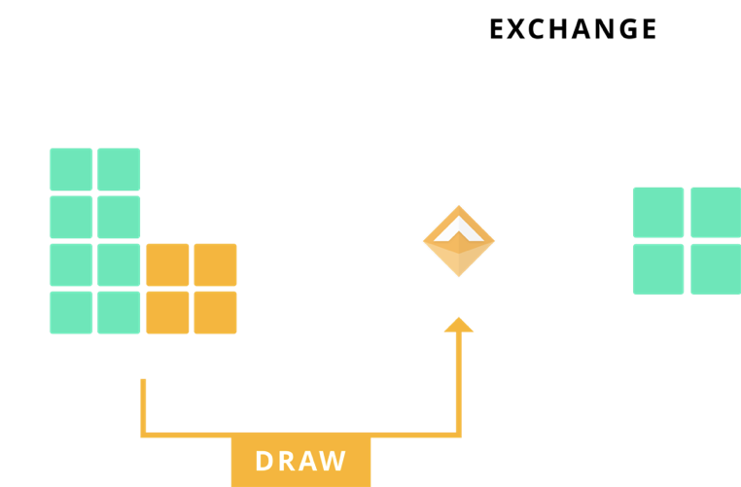
Credit System Mechanics
Purchase assets with issued Dai to achieve more exposure
Maker reduces counterparty risk and increases transparency
Notes:
Quick show of hands, how many of you are familiar with margin trading? For those of you who don’t know, margin trading is when you take out a loan and bet with borrowed money.
This allows you to multiply your exposure to an asset. For example if you were 3x long on Ethereum, and Ethereum went up +10% you would have +30% returns. Mind you, that this can go the other way around too. If ETH goes 33% you will used up 99% of your initial collateral and the loaning entity will seize your collateral in whats called a margin call (liquidation). However, there are also other ways to get liquidated. Your underlying collateral could drop in value enough for you to get margin called. This is what’s known as counterparty risk. Dai’s unique stability property practically eliminates counterparty risk.

Slide 25
Credit System Mechanics
Issue Dai with a Collaterized Debt Position (CDP)
Repay Dai + fee to retrieve collateral
Notes:
Quick show of hands, how many of you are familiar with margin trading? For those of you who don’t know, margin trading is when you take out a loan and bet with borrowed money.
This allows you to multiply your exposure to an asset. For example if you were 3x long on Ethereum, and Ethereum went up +10% you would have +30% returns. Mind you, that this can go the other way around too. If ETH goes 33% you will used up 99% of your initial collateral and the loaning entity will seize your collateral in whats called a margin call (liquidation). However, there are also other ways to get liquidated. Your underlying collateral could drop in value enough for you to get margin called. This is what’s known as counterparty risk. Dai’s unique stability property practically eliminates counterparty risk.

Slide 26
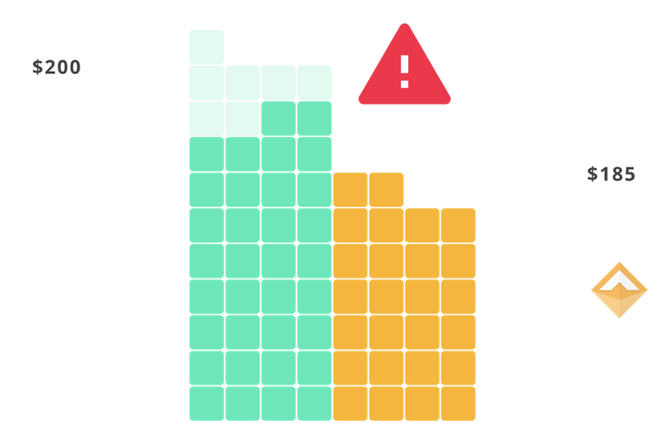
Credit System Mechanics
CDP is liquidated and sold for Dai if collateral values falls
Think of it as a decentralized margin call
Notes:
Quick show of hands, how many of you are familiar with margin trading? For those of you who don’t know, margin trading is when you take out a loan and bet with borrowed money.
This allows you to multiply your exposure to an asset. For example if you were 3x long on Ethereum, and Ethereum went up +10% you would have +30% returns. Mind you, that this can go the other way around too. If ETH goes 33% you will used up 99% of your initial collateral and the loaning entity will seize your collateral in whats called a margin call (liquidation). However, there are also other ways to get liquidated. Your underlying collateral could drop in value enough for you to get margin called. This is what’s known as counterparty risk. Dai’s unique stability property practically eliminates counterparty risk.

